Slide 1
Top 500 Movies by Production Budget
Geetha Kandukuri, Sandhya Datla, Frank Lindwall

Slide 2
Movie Data Description
Source- Kaggle
rank | Movies ranked by all time production budget
release_date | MM/DD/YYYY format
title | Movie title
production_cost | Total budget for movie ($US)
adjusted_production_cost | Total budget for movie adjusted for inflation (calculated)
domestic_gross | Gross revenue from theatres in USA ($US)
adjusted_domestic_gross | Gross revenue from theatres in USA adjusted for inflation (calculated)
Notes:
Frank

Slide 3
Movie Data Description (cont.)
worldwide_gross | Gross revenue from worldwide theatres (includes USA)
adjusted_worldwide_gross | Gross revenue from worldwide theatres adjusted for inflation (calculated)
theatres* | Number of theatres that showed the movie
runtime | Runtime in minutes
year | Year of movie release
Month | Month of movie release (calculated)
IMDB Rating | IMDB rating of movie (from OMDB API)
Notes:
Frank

Slide 4
Movie Data Description (cont.)
url* | Specific film’s URL on The Number’s site
opening_weekend* | Gross revenue of opening weekend in USD
mpaa* | Motion Picture Association Rating
genre* | Film’s genre
* fields were not included for analysis
Notes:
Frank

Slide 5

Questions that Guided our Analysis
Is there a correlation between production cost and gross revenue?
Is there a correlation between runtime and gross revenue?
Is there a correlation between IMDB rating and gross revenue?
Which month of release produces the highest gross revenue?
What are the highest rated movies on IMDB for each year?
How are we going to adjust cost and gross revenue values for inflation?

Slide 6
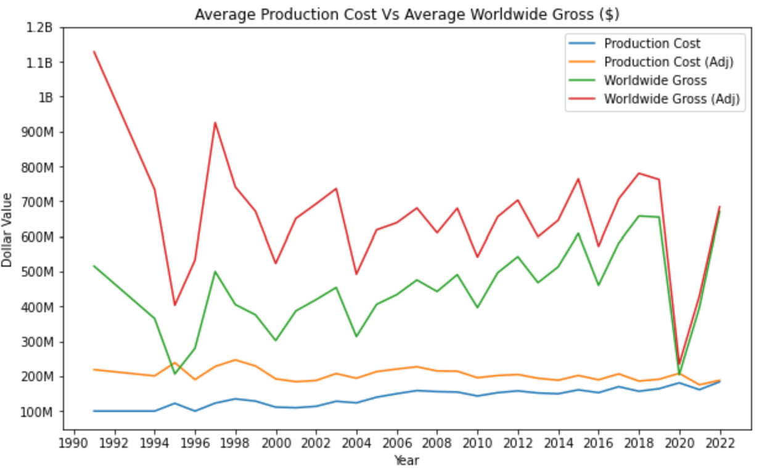
Overview of Cost vs Gross (Adjusted & Unadjusted For Inflation)
Some Fun Facts
91 - Terminator 2 (Gross almost 5 times Prod. cost)
95 - Cutthroat Island (Gross barely making ¼ th)
2000 - animated adventure movie The Road to El Dorado failure
2004 - The Alamo, another box office disaster
2020 - COVID

Slide 7
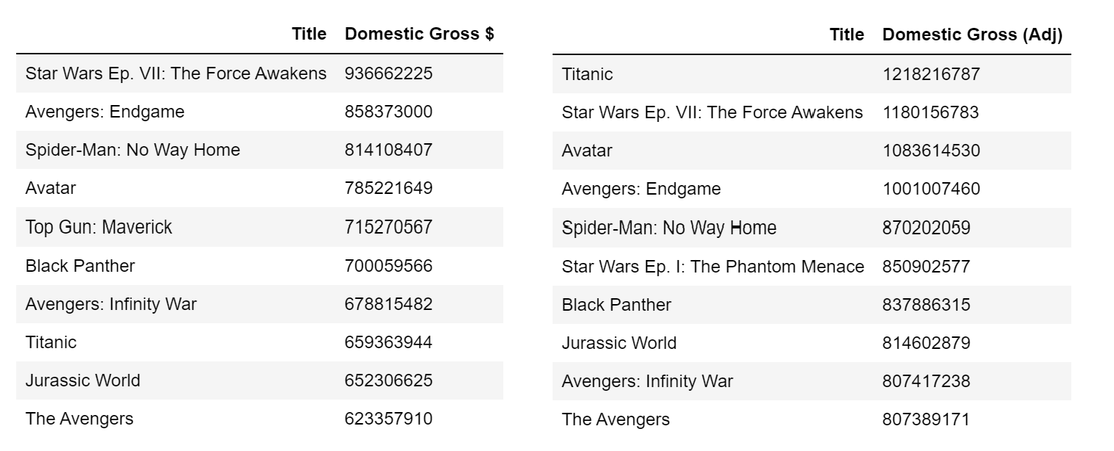
Top 10 Movies by Domestic Gross Revenue - Inflation, a Game Changer

Slide 8
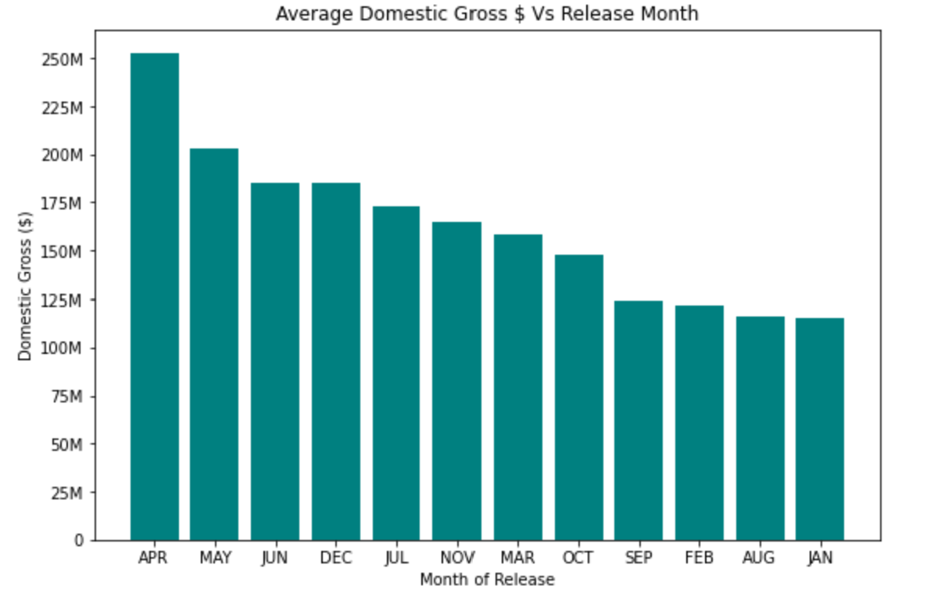
APRIL - Winner Of Domestic Gross Revenue

Slide 9
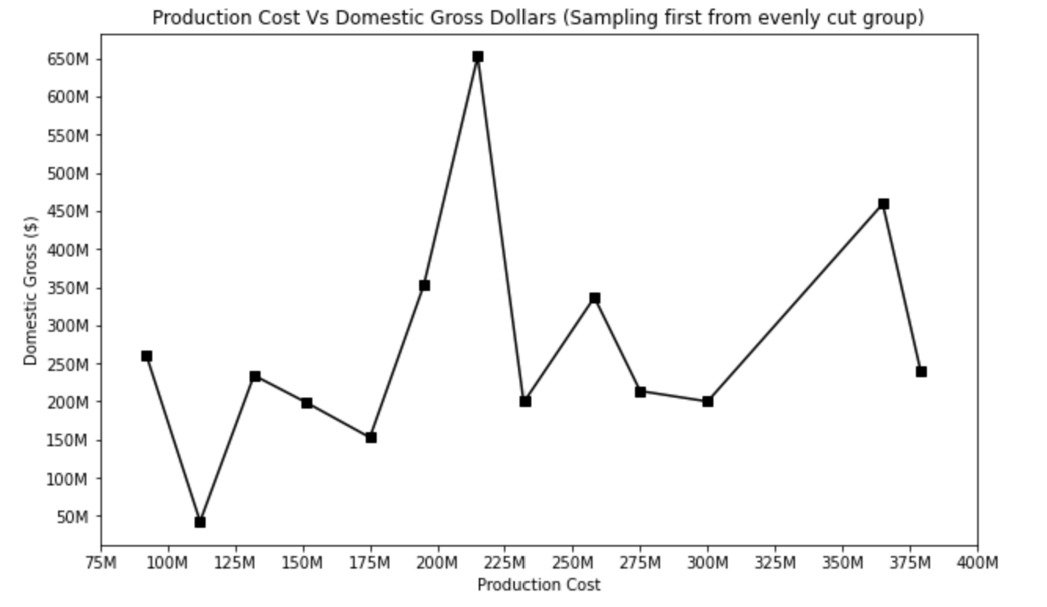
Eyeball Analysis By Sampling
Weak positive correlation
Sample too small to conclude

Slide 10
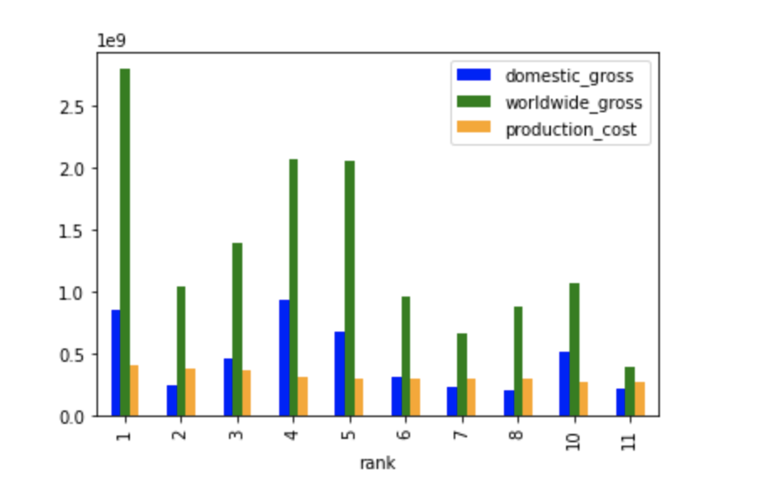
Rank vs Production Cost, Domestic & Worldwide Gross

Slide 11
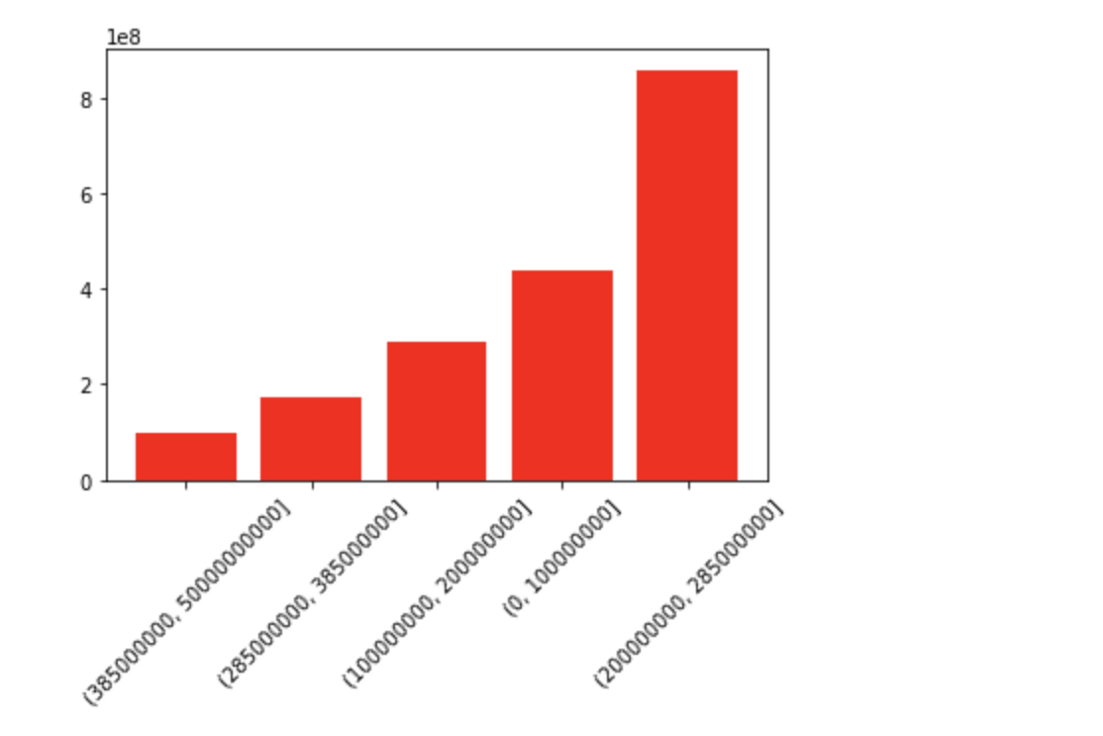
Budget Bins, Production Cost vs Domestic Gross Revenue Means

Slide 12
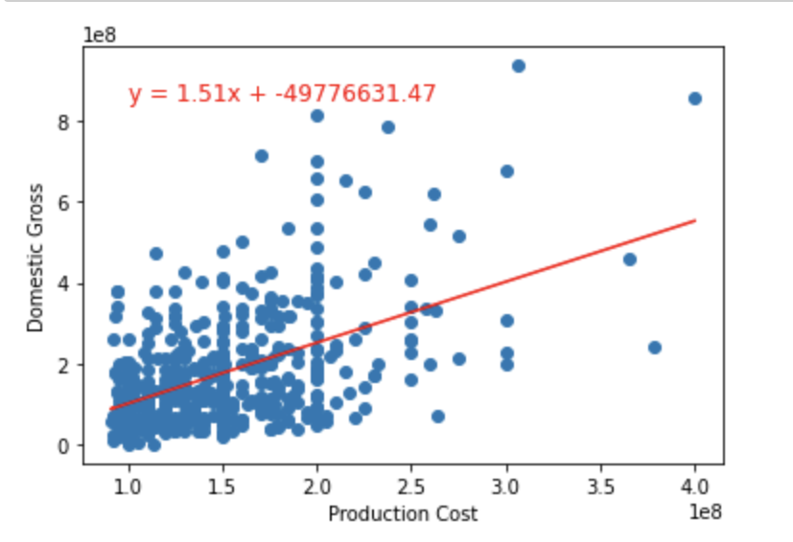
Linear Regression : Production Cost vs Domestic Revenue
R value = 0.509
Moderate positive correlation between domestic gross and production cost

Slide 13
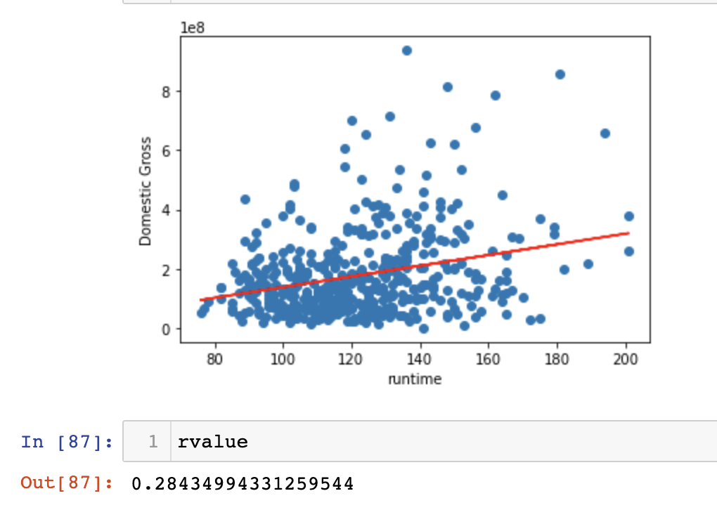
Linear Regression : Runtime vs Domestic Revenue
R value = 0.284
Weak positive correlation between runtime of movie and domestic gross

Slide 14
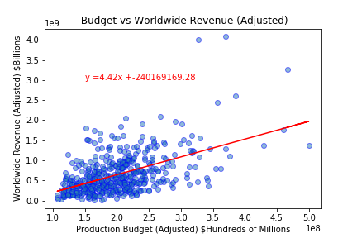
Production Budget vs Worldwide Revenue (Adjusted)
R Value = 0.523
Moderate, positive correlation between adjusted production budget and adjusted worldwide revenue
Notes:
Frank

Slide 15
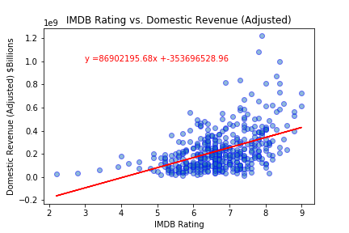
IMDB Rating vs. Domestic Revenue (Adjusted)
R Value = 0.469
Moderate, positive correlation between IMDB Rating and adjusted domestic revenue
Exponential regression potentially better?
Notes:
Frank Practical Significance of Slope

Slide 16
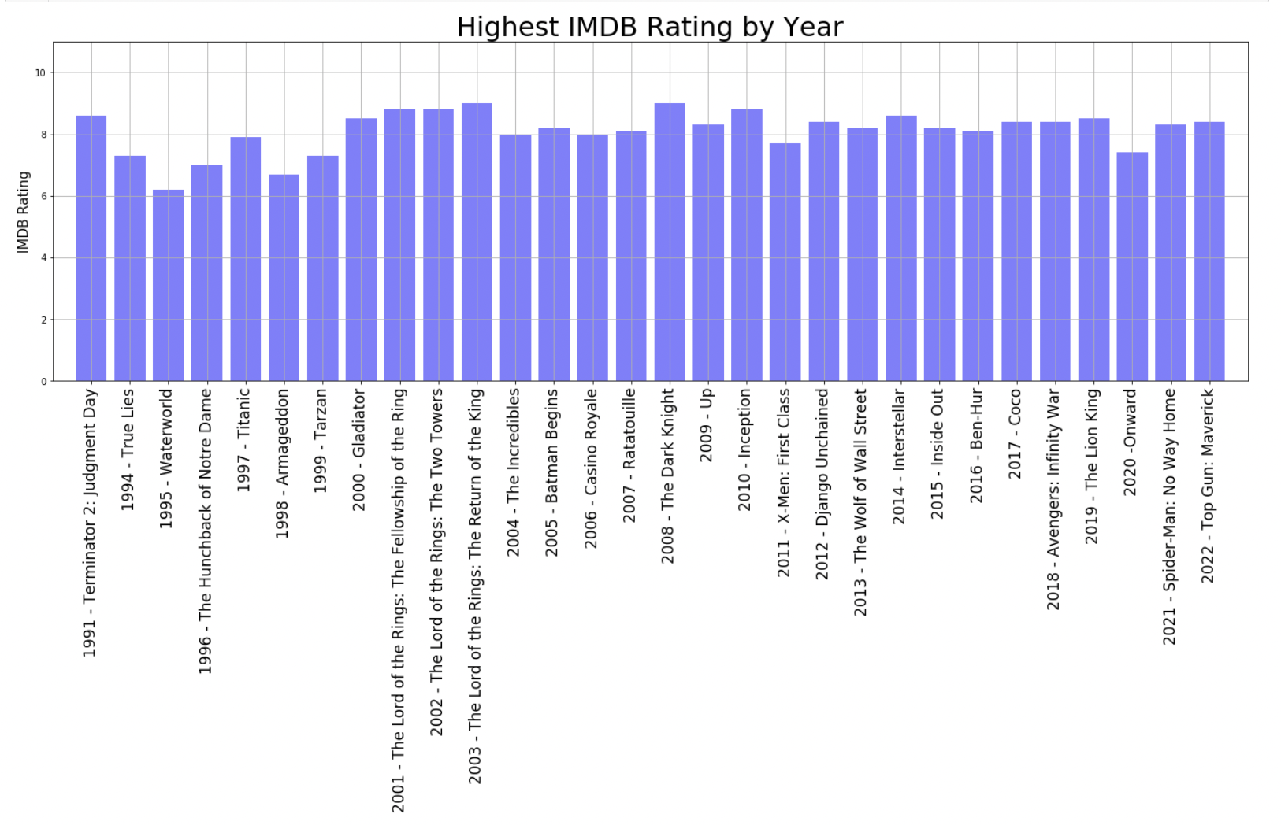
Notes:
Frank

Slide 17

Considerations for Next Time
Consistency of graph formatting could be improved
Labels, titles, and fields used
Original dataset had missing values which reduced our sample size
Sample size shrunk even smaller when we called OMDB API
Important to consider the type of analysis we are conducting when selecting a dataset to analyze
Use of additional modeling methods outside of linear regression

Slide 18
Works Cited
Dataset
Kaggle.com
Websites
StackOverflow
https://dfrieds.com (function to format ticks for large numbers)
APIs
OMDB for movie Rating
Nasdaq API for CPI values

